Slide 1
CASE STUDY ASSIGNMENT-1
Group Members:
1.18BCS6110-> Akshay Hooda
2.18BCS6112-> Shivnath Chauhan
3.18BCS6113-> Saksham Sharma
4.18BCS6114-> Yuvraj Koundal
5.18BCS6115-> Chitrang Juneja

Slide 2
ABSTRACT
In the following project we have been working for The Spark Funds, the main aim is to learn the global trends and dig up “The Best” sectors in a simultaneous consideration of the best suited countries for the investment of the funds of The Spark Funds in a few companies.
The aim is achieved in 5 checkpoints:
Data Cleaning
Funding Type Analysis
Country Analysis
Sector Analysis-1
Sector Analysis-2
Plots

Slide 3
PROBLEM SOLVING METHODOLOGY
The clear approach to get to the desired output is using Python Programming Language and the Data Analysis and Management techniques of the very same.
Steps to achieve desired results:
1. Data Extraction
2. Encoding & Decoding
3. Data Cleaning
4. Data Analysis
5. Plotting
using the python interface and environment.

Slide 4
ANALYSIS
The brief description of our case study will be explained with the help of the slices of respective “Checkpoints”, following are the ones:
CHECKPOINT-1→ DATA CLEANING
In this checkpoint the objectives were to present the unique company names in each of the databases.
Identifying unique key for the very same.
Merging the two data frames and making a master data frame.
CHECKPOINT-2→ FUNDING TYPE ANALYSIS
Different types of FUNDINGS are analyzed, primarily 4:
SEED, ANGEL, VENTURE and PRIVATE EQUITY.
So the type of investment chosen on the bases of frequency is ‘venture’.

Slide 5
ANALYSIS
CHECKPOINT-3→ COUNTRY ANALYSIS
Top 9 countries for the respective investment type, that is ‘venture’ type of funding and the top 3 investment favoring countries are:
USA
GBR
IND
which are chosen of the basis of English as an official language.
CHECKPOINT-4→SECTOR ANALYSIS 1
Extraction of the primary sector for each category from the given data.
Primary sector to be one of the eight main sectors present in the given data.

Slide 6
ANALYSIS
CHECKPOINT-5→ SECTOR ANALYSIS-2
In this checkpoint we aim to find total number of investments in each of the three countries that is→
USA[12012]
GBR[619]
IND[328]
We divided our data frame into three separate data frames for each country respectively.
In this data frame following constraints were followed:
Investment type- venture
Investment amount- 5 to 15 Million USD.

Slide 7
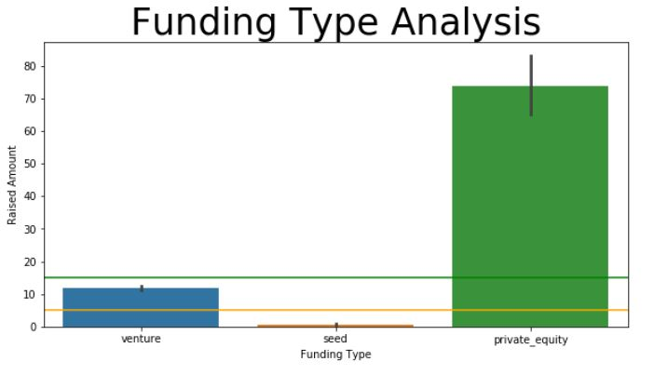
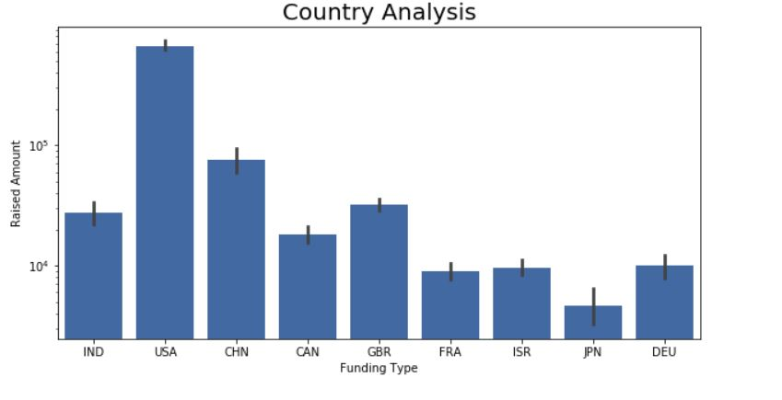
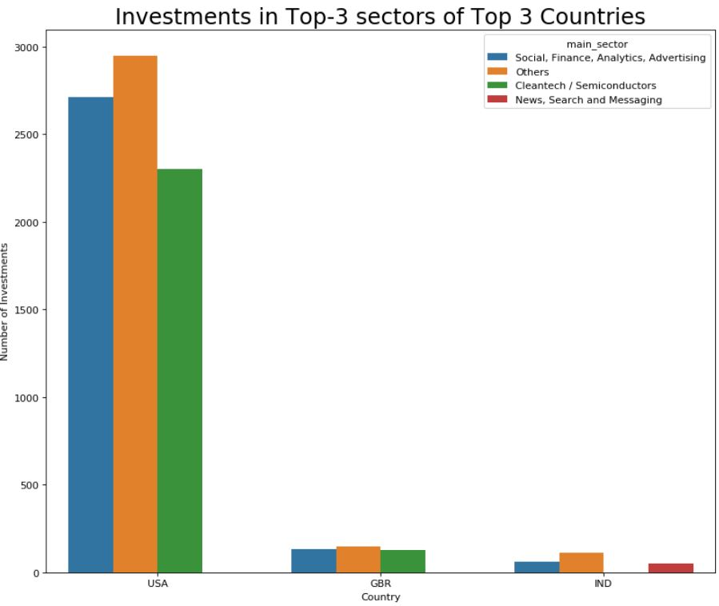
ANALYSIS
CHECKPOINT-6→PLOTS
Now presenting the findings to the respective CEO of the Spark Funds.

Slide 8
RESULT
Now presenting the results in the up lying checkpoints:
CHECKPOINT-1:
Unique companies- 66368
Unique key- “permalink”
CHECKPOINT-2:
Most suitable investment type: “VENTURE”
CHECKPOINT-3:
Top three countries on the basis of highest amount of funding and English as a primary language – USA, BRITAIN and INDIA

Slide 9
RESULT
CHECKPOINT-4:
Mapped the primary sectors of each company with their respective main sectors for investment.
CHECKPOINT-5:
Most heavily invested sectors for each of the country:
Country-1→Others; SOCIAL,FINANCE,ANALYTICS,ADVERTISING
Country-2→Others; SOCIAL,FINANCE,ANALYTICS,ADVERTISING
Country-3→Others; SOCIAL,FINANCE,ANALYTICS,ADVERTISING
Checkpoint-6:
Reference of plots presented.
**********************************************************************************************************************
End

